Slide 1


AIRLINE Reservation
SYSTEM

Slide 2
Airline reservation system
Prepared By:-
Name: Mohit Jadav
Enroll no: 24002171310047
Batch:C7
Branch : CST
Name : Harshul Patel
Enroll no: 24002171310118
Batch: C7
Branch: CST
Student Name: Princy Patel
Enroll no: 24002171310108
Batch:C7
Branch: CST

Slide 3

Purpose OF THE PROJECT
The Purpose of our Project is passengers can search flights and book tickets online instead of visiting airline offices . And Enables checking seat availability, flight timings, and ticket prices in real-time . And Passengers can cancel without much hassle.

Slide 4
TOOLS & TECHNOLOGIES USED
DATA STRUCTURES USING JAVA | JAVA-II | DATABASE MANAGEMENT
Use of Binary Search Tree to search Flights. | File Handling to get ticket book Info. | Tables for Administrator,custdata, Domestic_flights,flights, International_flights
Circular LinkedList for storing For Passenger / customer details. | Exception Handling for Smooth operations | SQL queries for inserting , updating and retrieving data
 | JDBC connectivity for database interaction | Constraints and Relationships(Primary Key , Foreign Key)
 |  | Trigger when Update happens,procedures
Made with Genspark

Slide 5
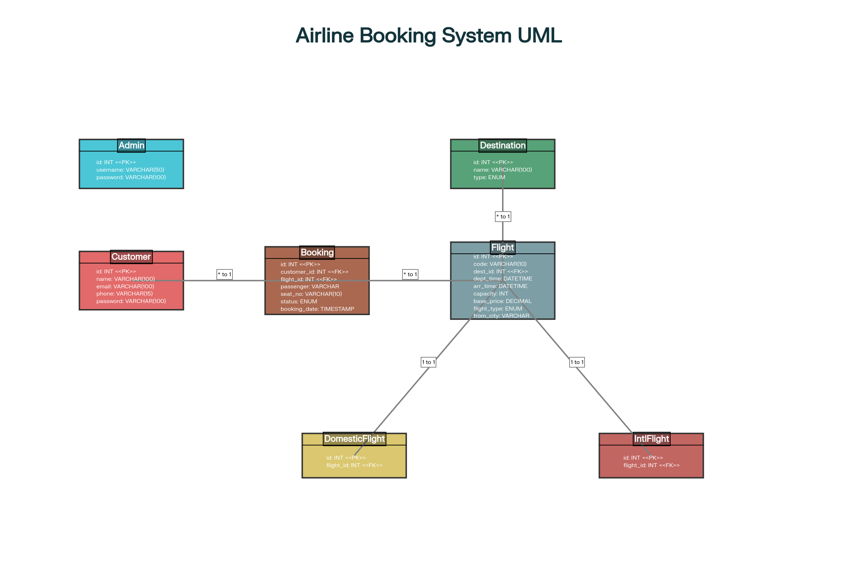
Class Diagram
Class Diagram

Slide 6
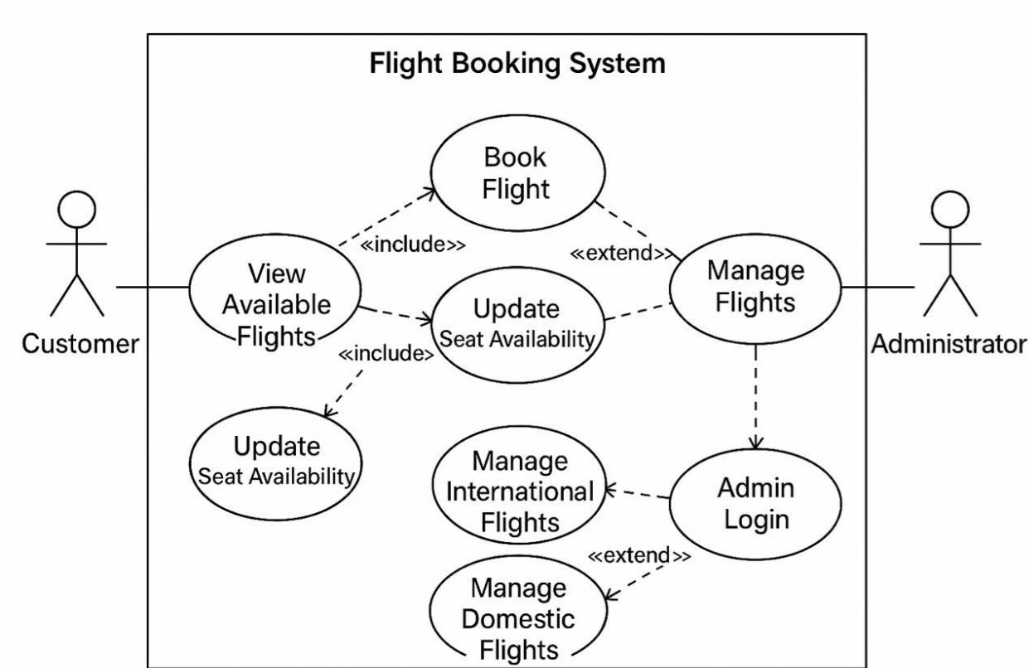
USE case Diagram

Slide 7
MERITs
1. Time-Saving & Convenience
2.Passengers can book tickets online or
agents without visiting airline office.
3.24/7 AvailabilityReservation systems
round the clock, allowing bookings anytime,
anywhere.
4. Cost Efficiency Airlines save money by reducing manpower and paper WORKS.

Slide 8
demerits
GUI(Graphic user interface)
Payment interface for the tickets with authorities like Google pay.
Authentication for the user email and mobile no.
Elderly people or those without internet access may find it difficult to use online booking systems.

Slide 9

Conclusion
The project successfully integrates multiple technologies:
  DBMS: Tables, constraints, and triggers for data integrity and backup.
  Data Structures: Circular Linked List used for efficient donor management.
  Java OOP + JDBC: Handles application logic and database connectivity.
Result: A secure, efficient, and reliable Airline Reservation System that make more time saving and easy to use for customer.
This Photo by Unknown Author is licensed under CC BY-SA

Slide 10
Thank you

